Slide 1
Computational and modeling approaches to multi-scale anatomical description of neuronal circuitry
Linus Manubens-Gil
Supervisors: Mara Dierssen and Jordi Garcia-Ojalvo
Systems Biology Program – Centre de Regulació Genòmica (CRG)
18th January 2018
Notes:
(Thank you for the introduction)
During the following 40 minutes I will present my Thesis work, which addresses the impact of neuromorphological properties on the wiring of neuronal networks through computational and modeling approaches using microscopy imaging of brain circuits.

Slide 2
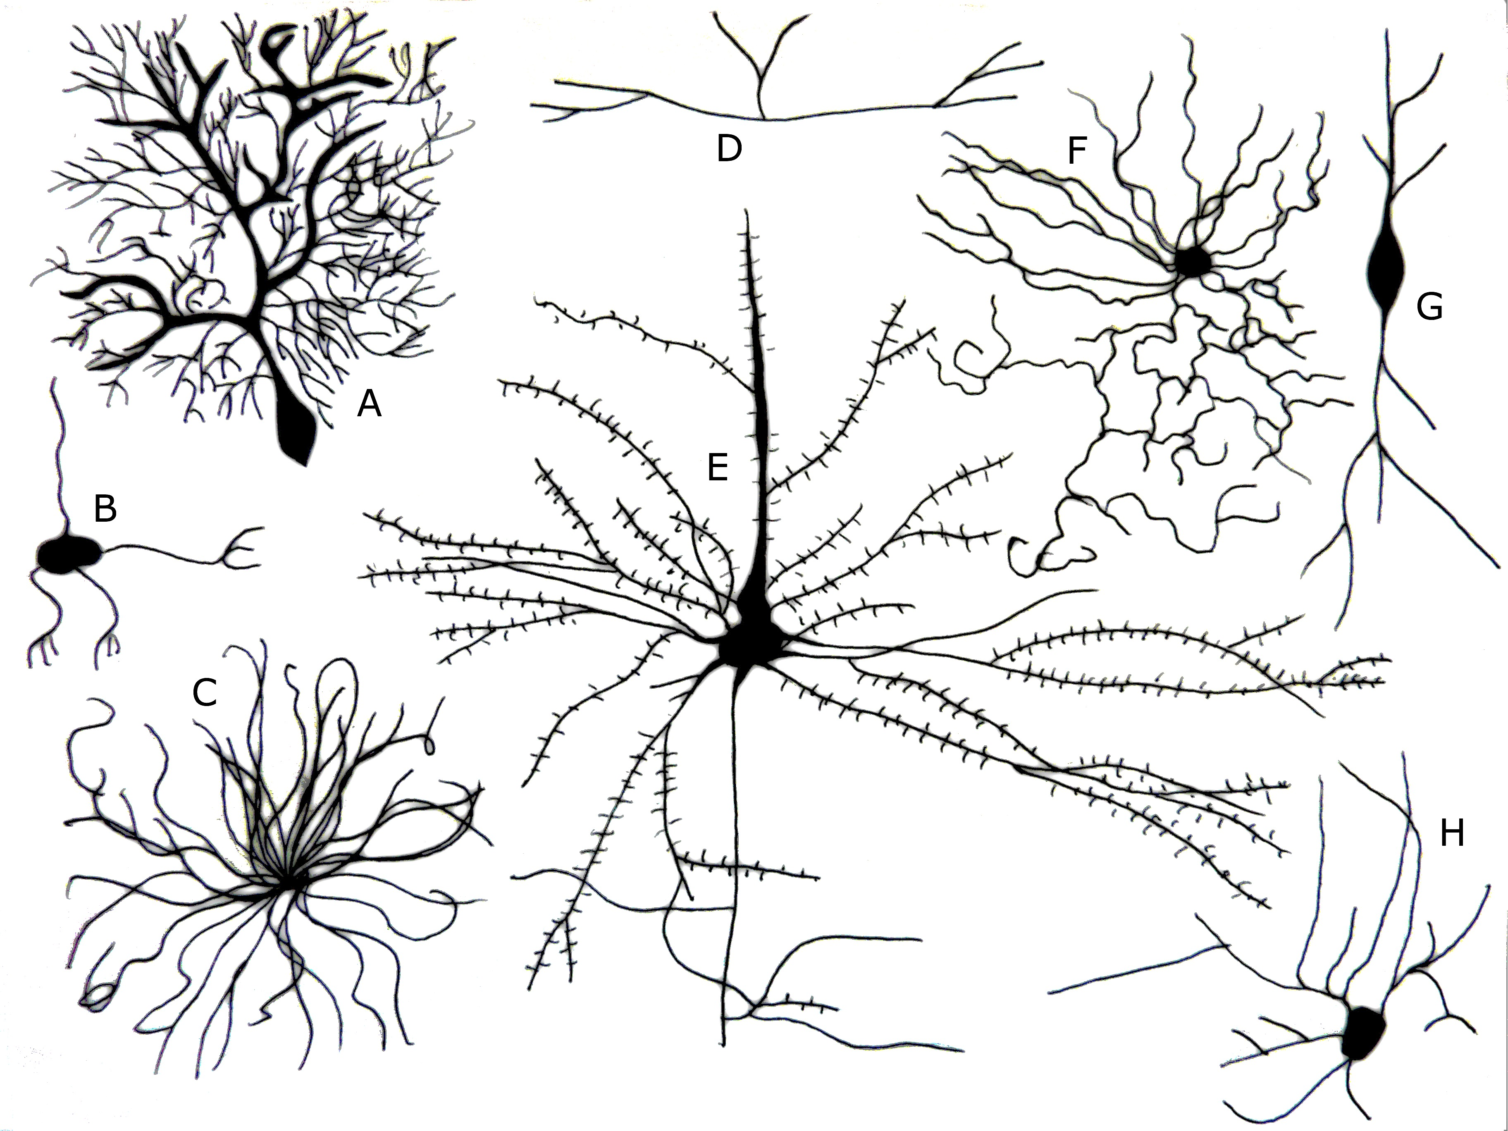
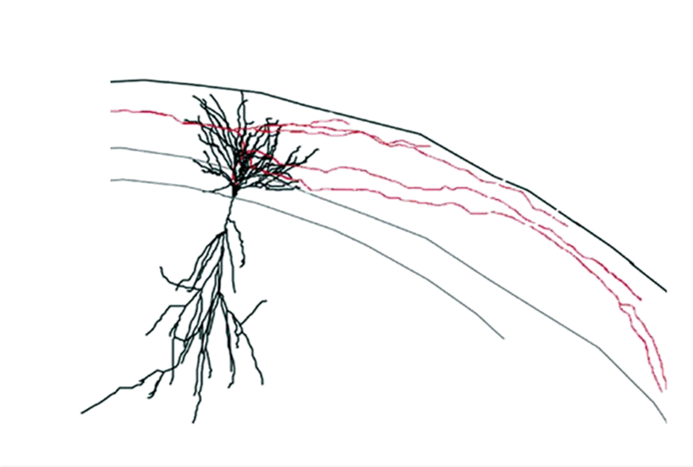
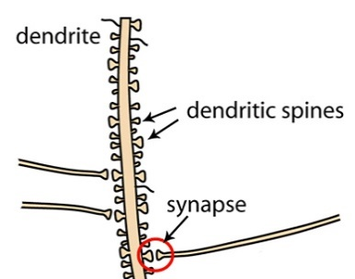
How anatomical details of single neurons affect the wiring of the networks?
(Ferris Jabr, based on reconstructions and drawings by Ramón y Cajal)
(www.neuwritesd.org)
Notes:
Neurons are cells highly specialized in information processing. To this aim, they have a specific structure, the dendritic tree, for receiving information coming from other brain areas. The information is received through individual contact points in membrane specializations called dendritic spines.
We can infer that the configuration of the dendritic tree constrains the capacity for integrating information of the neurons.
This hypothesis is reinforced by the fact that, as you can see in this drawing from Ramón y Cajal, there is a myriad of dendritic tree morphologies in different brain regions, depending on the neuronal networks they are embedded into.
Most of the existing studies have explored the impact of dendritic tree morphology at the single cell level. However, the relationship between the spatial configuration of dendritic trees and the functionality of neuronal networks is not known.
--------------------------------------------
One hundred years ago Santiago Ramón y Cajal set the foundations of modern Neuroscience. He observed that the brain is formed by individual cells, the neurons, and that those appear in a variety of shapes. He spent most of his time studying how those shapes could be contributing to cognition.
The neurons are cells specialized in the transmission of information. They can be divided in two parts, the dendritic tree, which receives signals, and the axon, which sends them. The dendritic trees are membrane specializations that usually form highly branched paterns to integrate signals from many input locations. During this last century, we have learned that, by their shape, neurons sift through all the possible connections they could make and perform specific computations.

Slide 3
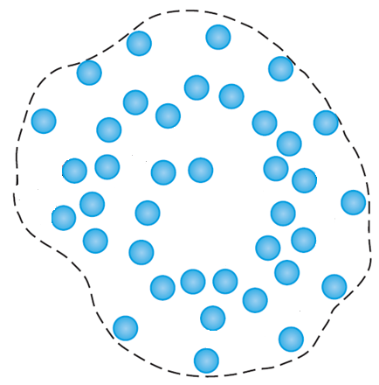
Neuronal design: the optimality of dendritic tree morphology
Axons
Target space
(Schröter, Paulsen & Bullmore, 2017)
Notes:
Most of the existing studies have explored the impact of dendritic tree morphology on optimality, defined as the best neuronal configuration allowing to fill optimally a target space while minimizing conduction time and at a low cost.
We define the target space as the area covered by the dendritic tree of a neuron and the target points as the axonal terminals that reach it
What has been done has been to try to understand is what configurations (
It has been proposed that neurons grow to fill optimally the space that has to be reached to connect with target points, which you can see in blue in this image.
obeying a trade-off between the amount of material spent and the conduction time it requires for any signal to reach the nucleus of the cell.
Such a case is depicted schematically in (1).
It is assumed that neurons with too long (2) have too long conduction times.
When they have few branches (3) they do not fully sample the target space.
And when they have too many branches (4) they could be oversampling it.
From these rationalizations two scaling laws have been derived. They relate easy-to-obtain metrics, namely, the total dendritic length (L), and the number of branch points (bp) or the radius of the tree (R).
The first law was derived by Hermann Cuntz and colleagues reasoning that the average minimal distance between points distributed in the space is proportional to the square root of the average area occupied by each point in a 2D case.
By assuming that the number of branch points is proportional to the target points, the derived scaling law predicts that the total dendritic length is proportional to the number of branch points raised to the power of one half.
Alternatively, by drawing an analogy between the maximization of the connectivity repertoire at a given material cost in neurons and the maximization of the entropy for a given energy in statistical physics, Wen and Chklovskii derived a scaling law between the total length of the tree and its radius with power 0.44.
Each point in these plots represents (left) the number of branch points and total length or (right) the total length and tree radius of reconstructed single neurons. It can be seen that both power laws fit well the distributions of real trees.

Slide 4
Neuronal design: the optimality of dendritic tree morphology
Axons
Target space
(Schröter, Paulsen & Bullmore, 2017)
Notes:
To define this concept we have to imagine that neurons have to contact, how many target points has a neuron to reach
We could imagine several configurations to fill this space

Slide 5
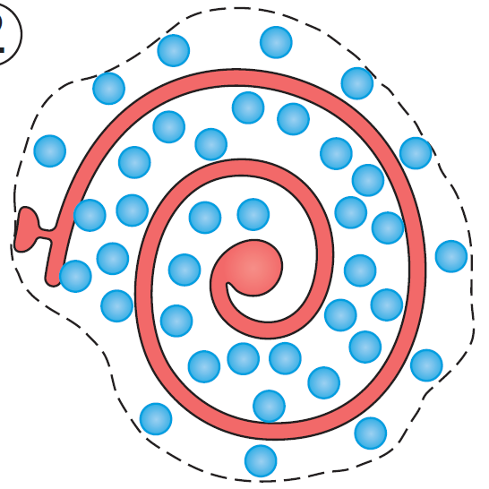
Neuronal design: the optimality of dendritic tree morphology
Dendrite
+ Minimal material
+ No redundant connections
- High conduction time
(Schröter, Paulsen & Bullmore, 2017)
Notes:
In this first example, a configuration minimizing material and cost, would be able to reach most of the target pints, but at the expense of a high conduction time

Slide 6
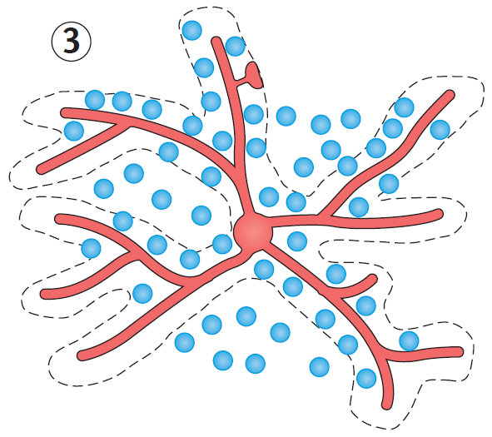
Neuronal design: the optimality of dendritic tree morphology
+ Minimal material
+ Low conduction time
- Missing connections
(Schröter, Paulsen & Bullmore, 2017)
Notes:
Biology has found a solution to this problem by generating branch patterns. This allows to have low conduction times at minimal material cost. However, in this example, branch patterns can still be suboptimal, because of missing connections

Slide 7
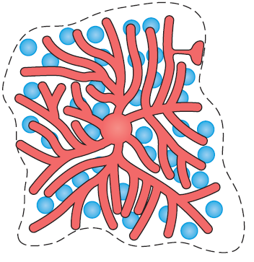
Neuronal design: the optimality of dendritic tree morphology
+ Low conduction time
- Redundant connections
- High material cost
(Schröter, Paulsen & Bullmore, 2017)
Notes:
In an opposite case, a branch pattern like this could be oversampling the target space, with high levels of redundancy and high cost

Slide 8
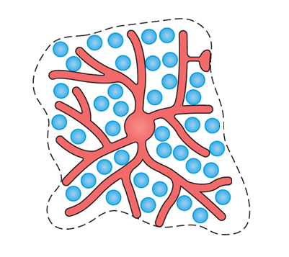
Neuronal design: the concept of optimality
Sub-optimal
Optimal
Sub-optimal
(Schröter, Paulsen & Bullmore, 2017)
Notes:
In fact real neurons are in between these two cases,

Slide 9
Neuronal design: the concept of optimality
Sub-optimal
Optimal
Sub-optimal
+ Minimal material
+ Low conduction time
+ No redundant connections
(Schröter, Paulsen & Bullmore, 2017)
Notes:
Obeying a trade off between minimal material cost, low conduction time and optimal connectivity

Slide 10
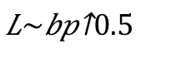
The optimal wiring scaling law
Optimal wiring predicts a ½ power law between dendritic wiring length and the number of branching points
(Cuntz, Mathy & Häusser, 2012)
$$L\sim {bp}^{0.5}$$
Notes:
Based on this rationale, Hermann Cuntz and colleagues using Euclidean geometry, made simple predictions for an optimized circuit. They derived a scaling law that predicts that the total dendritic length is proportional to the number of branch points raised to the power of one half.

Slide 11
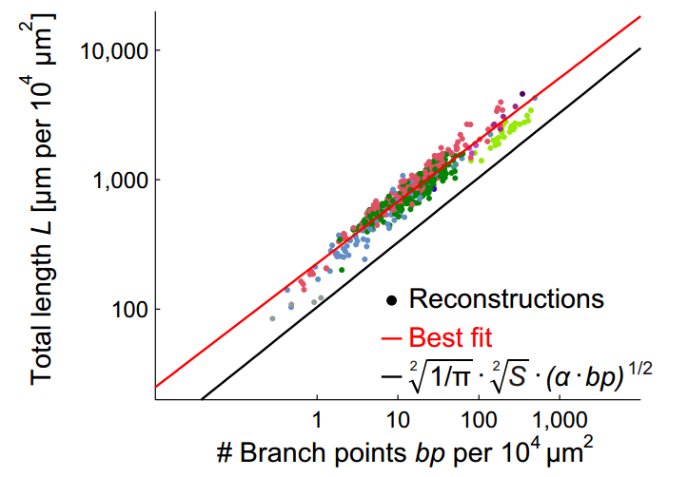
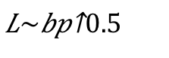
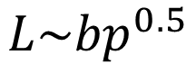
The optimal wiring scaling law
$$L\sim {bp}^{0.5}$$
$$L\sim {bp}^{0.5}$$
(Cuntz, Mathy & Häusser, 2012)
Notes:
This plot represents the number of branch points, that is proportional to the target points in dendritic trees, and total length of reconstructed single neurons. As you see the power law fits well the distributions of real trees of different cell types represented in different colors.
The average minimum distance connecting two points is proportional to the square root of the average area occupied by each target point. Thus, a lower bound for the total length of a tree connecting all the points is proportional to r=c*sqrt(A)=c*d^(-1/2). Given that the number of points is n=A*d, L = c*A*sqrt(d) = c*sqrt(A*n).
The following reasoning, using Euclidean geometry, leads to simple predictions for such an optimized circuit. A given number of synaptic points n is distributed over a volume V with density d¼n=V. The average volume that one point takes up is V′¼1=d¼d−1 (Fig. 1A). The average minimal distance r between two points is therefore proportional to the cubic root of V′ or r ¼c·d−1=3, where c is the proportionality constant. The total length of dendrite L connecting all synaptic points optimally is therefore proportional to n·d−1=3. Thus, L¼c·V ·d·d−1=3 ¼ c·V ·d2=3, a 2/3 power law. Replacing d by n=V, L¼c·V ·ðn=VÞ2=3 ¼c·V1=3 ·n2=3. If the piece of dendrite r ¼c·d−1=3 added by each point is simply the radius of the sphere with volume V′, L fulﬁlls criteria of a lower bound for acompletespaceﬁllingandoptimalwiringwhilec¼ð 3=4πÞ1=3.Thetotal length of a dendrite L in relation to number of points n and volume V becomes L¼ ﬃﬃﬃﬃﬃﬃﬃﬃﬃﬃ 3=4π3 p · ﬃﬃﬃﬃ V3 p n2=3: Correspondingly, the total length in planar dendrites is proportional to the surface S by L¼c·S·d·d−1=2 ¼c·S·d1=2 and equivalent considerations lead to the following relationship for a lower bound of an optimal space-ﬁlling dendrite in two dimensions: L¼ ﬃﬃﬃﬃﬃﬃﬃﬃ 1=π2 p · ﬃﬃﬃ S2 p n1=2:

Slide 12
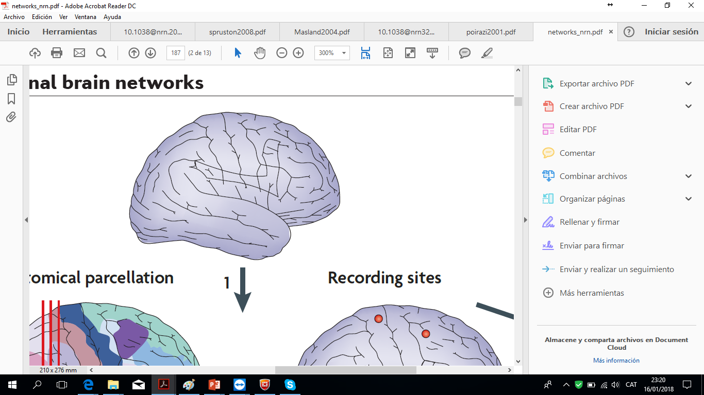
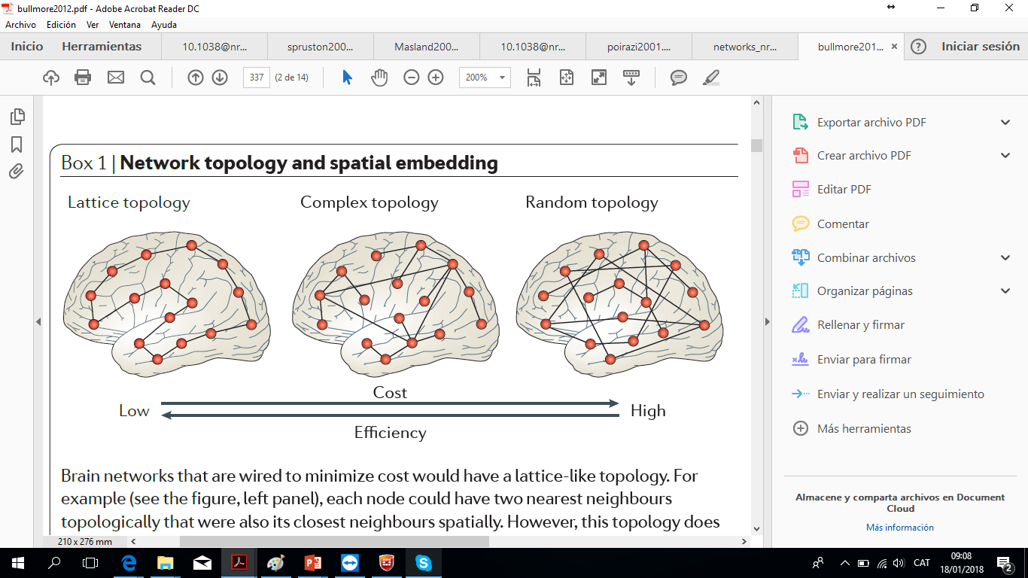
Optimality in macroscopic neuronal circuits
(Bullmore & Sporns, 2012)
Notes:
Although this scaling law predicts optimal filling of the target space, it does not allow to infer topological properties at the local network level
Whole-brain studies have identified organizational principles in macroscopic neuronal circuits using the framework of graph theory. Here the material cost is defined as the number of connections among brain areas, and conduction time would be given by the distance between them. This would define a concept called routing efficiency which is the average minimum distance between areasand would represent the efficiency in processing information
Whole brain connectivity could minimize material cost using a lattice topology, or could maximize the efficiency in processing information, with a random topology. However, experimental measurements using magnetic resonance imaging have shown that in many species the structure of the networks lays at some point between these two cases, usually having many short range connections and few long-range connections increasing the efficiency of the network at a small cost.

Slide 13
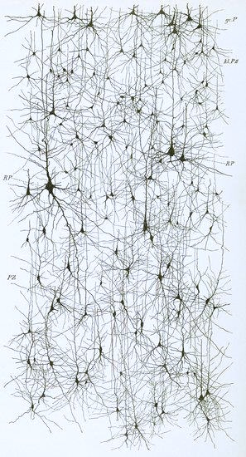
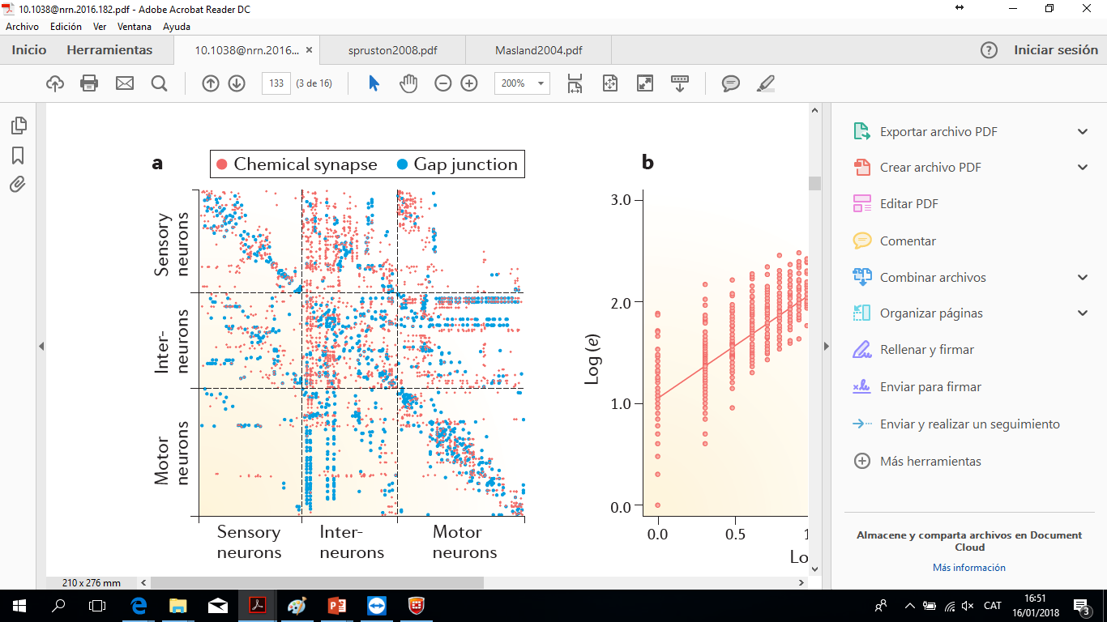
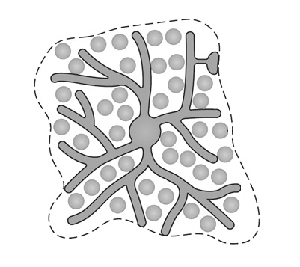
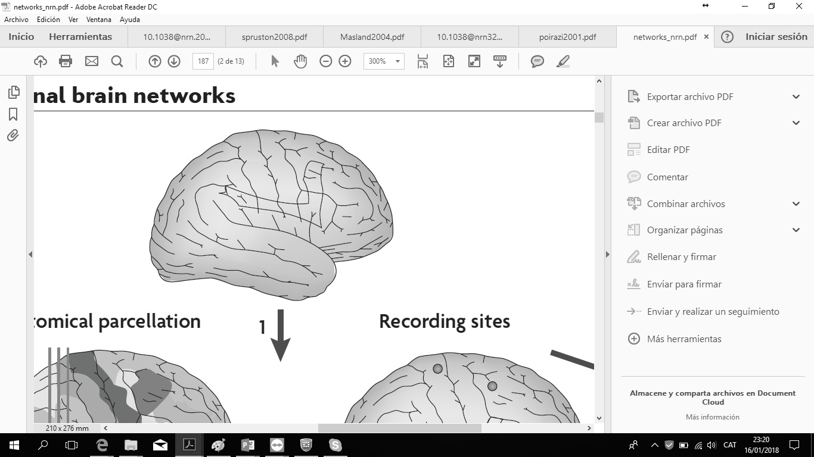
Defining the organizational principles of neuronal networks at the cellular scale (micro-connectomics)
Micro
Meso
Macro
(Schröter, Paulsen & Bullmore, 2017)
Notes:
However the fundamental question of this thesis lies in-between, since we want to extrapolate the conclusions drawn at the single-cell level to the local network properties that lie in a mesoscopic scale
The efforts done have been mostly descriptive, as in this example, where the complete cell-to-cell connectivity in the C. Elegans brain was mapped, but no effort to understand the organizational principles or to define their relation with single cell morphology has been undertaken until now.

Slide 14
Hypothesis
Dendritic organization has significant implications on neuronal network topology and suboptimal dendritic configurations could affect computational capabilities in pathological conditions
Cortical pyramids reconstructions and drawings by Cajal.
From. Cajal's Butterflies of the Soul.
Science and Art. Javier DeFelipe.
Notes:
Thus, the hypothesis behind my work is that:
And that suboptimal dendritic configurations could affect computational capabilities in pathological conditions

Slide 15
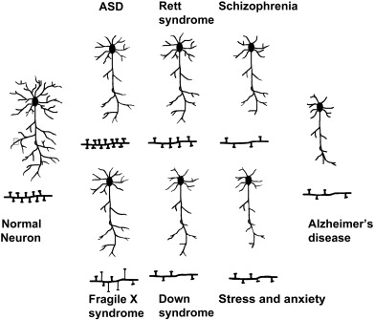
Brain pathology provides an excellent opportunity to explore the relevance of fine structural details
Normal
neuron
Fragile X
Down syndrome
Stress and
anxiety
(Kulkarni & Firestein, 2012)
Dendritic morphology alterations in pathological conditions correlate with defective cognitive performance
Notes:
In fact, intellectual disabilities show alterations at the cellular level, which are accompanied by cognitive impairments.
Those alterations can be seen as suboptimallly configured systems within the optimality frameworks that I have introduced.

Slide 16
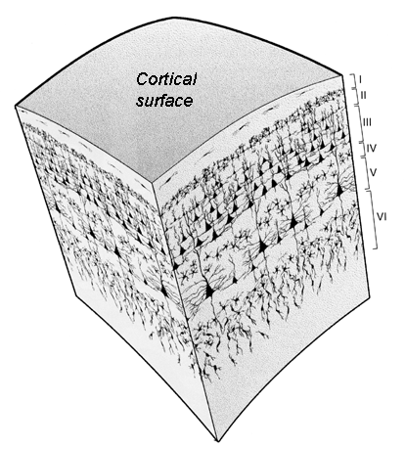
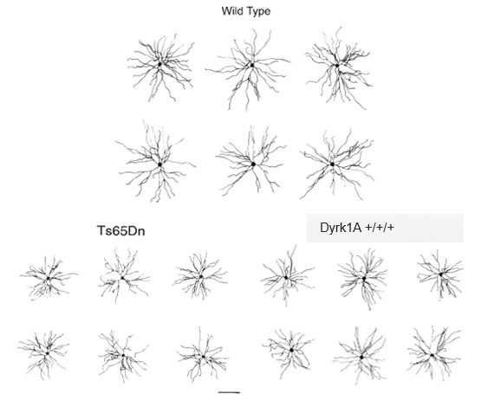
How alterations in single-neuron morphostructural features in intellectual disability sculpt local network topology?
Single-neuron basal dendritic tree microanatomy (cortical layer II/III)
Tailored computational models to explore local network topology
Notes:
The first question of my thesis is how such morphological alterations at the single cell-level will constrain the connectivity of neuronal networks at a local scale
To this aim we have first studied the microanatomy of dendritic trees of cortical pyramids to define the optimal wiring scenario
To understand how single cell optimality impacts the circuit level, I tailored a computational model to explore how local network topology is affected by alterations in single-neuron morphostructural features in mouse models of intellectual disability.

Slide 17
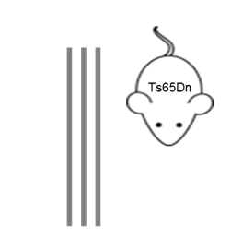
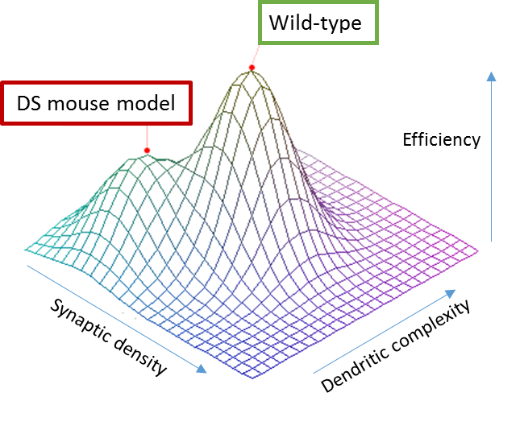

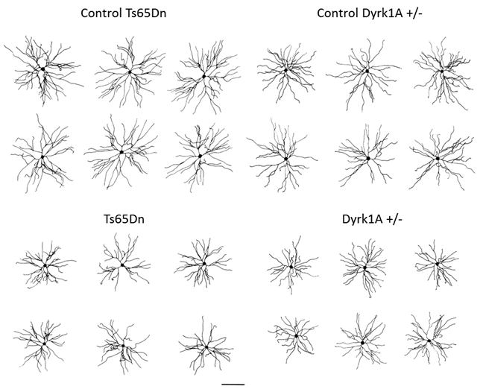
Intellectual disability mouse models as in vivo systems
Healthy
Altered microanatomy
Perturbed pyramidal microanatomy correlating with deficits in executive function
Notes:
I used existing neuronal reconstructions of different mouse strains and Down syndrome models, the Ts65Dn, which bears a partial trisomy of mouse chromosome 16, and the Dyrk1A heterozygous that resembles cases of human monosomy leading to intellectual disability. Both models present subtle dendritic alterations along with behavioral disturbances, allowing to gather a comprehensive view of the pathological deviations in intellectual disability.
I reasoned that the possible strain-dependent variation in the normal dendritic phenotypes would define a range of optimality, while Down syndrome cases would be suboptimal. I expected that dendritic architecture changes in intellectual disability would have a strong impact on complex network topologies.

Slide 18
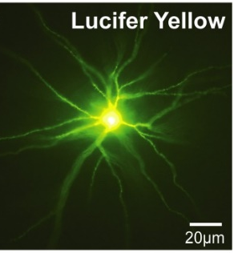
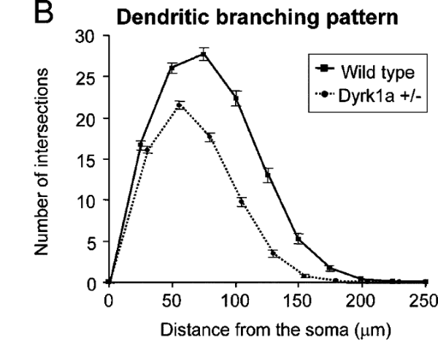
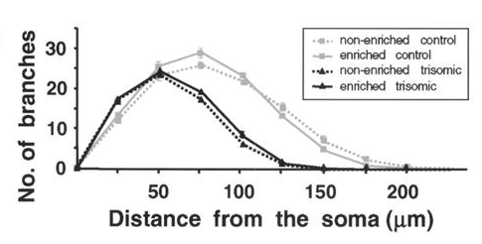
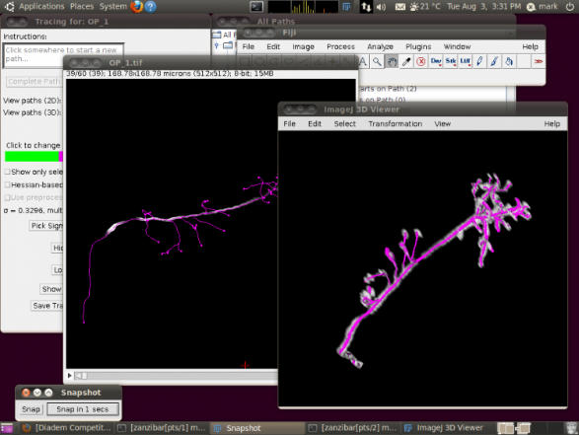
Datasets: LY-labelled and reconstructed M2 cortical layer II/III basal dendritic trees
Scale bar = 100 µm
(Dierssen et al., 2003)
(Benavides-Piccione et al., 2005)

Slide 19
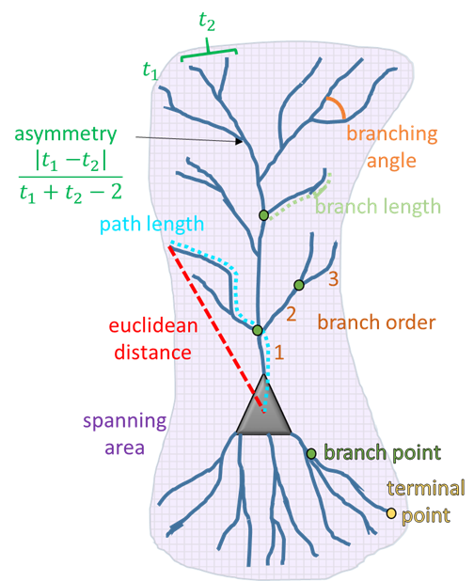

Metrics to quantify structural traits and analyse topological properties of single neurons
Scale bar = 100 µm
Notes:
I repeated the neuronal reconstructions using Fiji and the tress toolbox branching statistics to obtain new metrics allowing to define the topological properties
Specifically, (metricas)

Slide 20
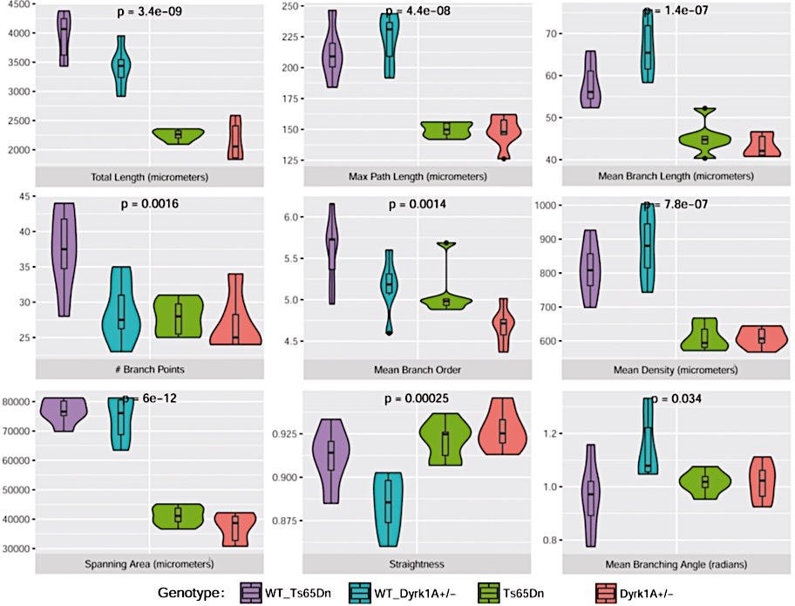
Single-neuron morphological metrics
Intellectual disability mouse models show reduced span and complexity of dendritic trees
Notes:
We studied a number of metrics such as dendritic span, and density, branch number and straightness, among others and we identify main perturbations in dendritic span and complexity, which were significatly reduced in DS mouse models

Slide 21
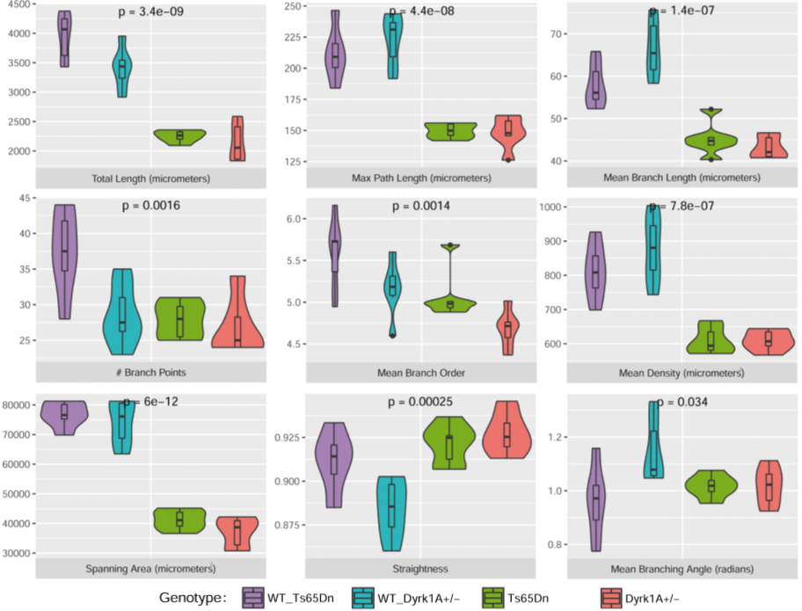
Do microanatomy alterations imply suboptimal wiring?
Notes:
To determine optimal dendritic wiring we focused on total length, which is significatly

Slide 22
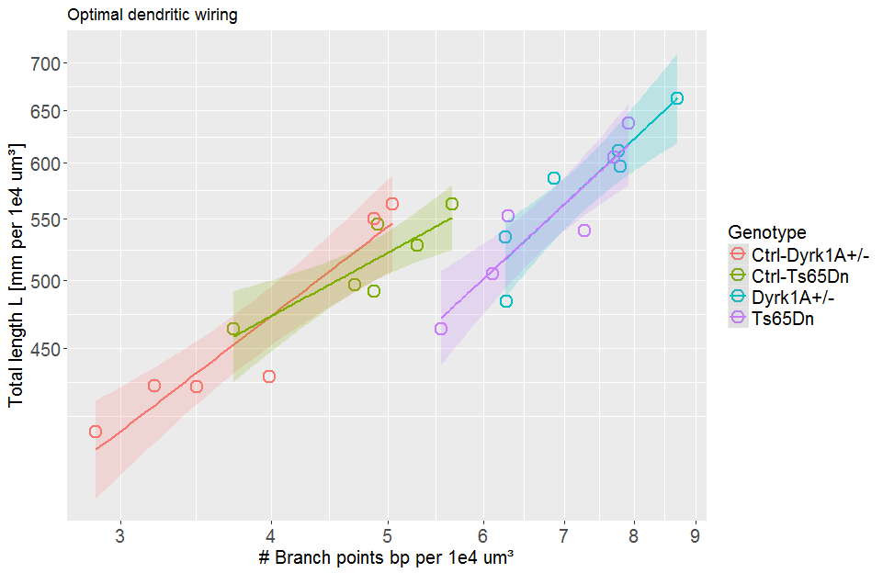




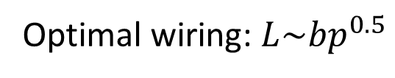
Down syndrome mouse models deviate from optimal scaling for length and number of branches
Optimal wiring: $L\sim {bp}^{0.5}$
Ctrl - Ts65Dn $L\sim {bp}^{0.45}$ s.e.=0.13
Total length L [mm per 10⁴ µm³]
Ctrl - Dyrk1A +/- $L\sim {bp}^{0.65}$ s.e.=0.11
Ts65Dn $L\sim {bp}^{0.74}$ s.e.=0.15
Dyrk1A +/- $L\sim {bp}^{0.75}$ s.e.=0.16
# Branch points bp per 10⁴ µm³
Notes:
Using the scaling law derived by Cuntz we found that both control strains are ner to optimal, while both Ts65Dn and Heterozgous neurons are suboptimal

Slide 23
Intellectual disability mouse models present sub-optimal space filling
Optimal
Slightly sub-optimal
Sub-optimal
The metrics used do not discriminate important functional properties
Notes:
thus our results show that genetic perturbations leading to intellectual disability leads to impaired ability of dendrite to fill a target space. However this optimality accounts for both the maximization of connectivity and minimization of conduction time, thus impeding to discriminate between these two functional aspects, and thus may not be able to grasp the subtle differences bewteen Ts65Dn and Dyrk1A

Slide 24
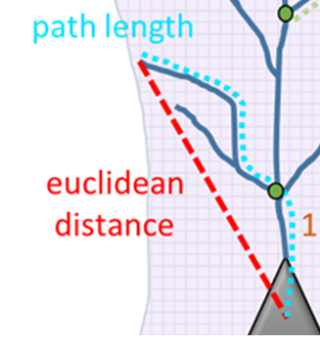
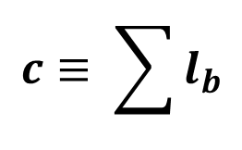
Defining an efficiency morphospace
Cost
$$c≡ \sum{l_{b}}$$
Notes:
I define the cost as:

Slide 25
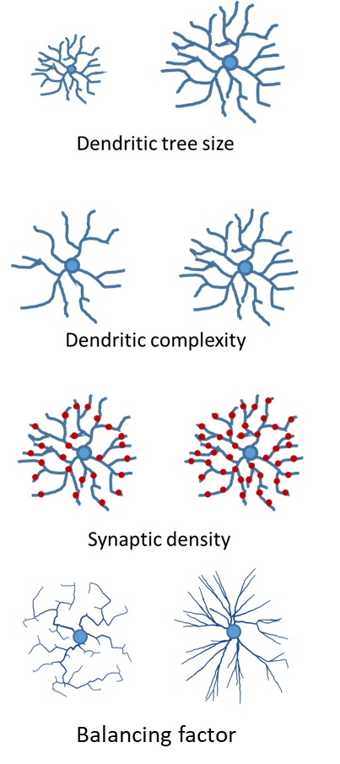
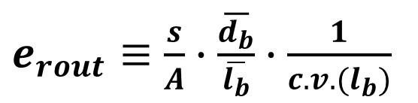
Defining an efficiency morphospace
Routing efficiency
$e_{rout}≡\frac{s}{A}∙\overline{\frac{d_{b}}{\overline{l_{b}}}}∙\frac{1}{c.v.(l_{b})}$
High efficiency
Low efficiency
Notes:
Normalization to WT values has to be mentioned here

Slide 26
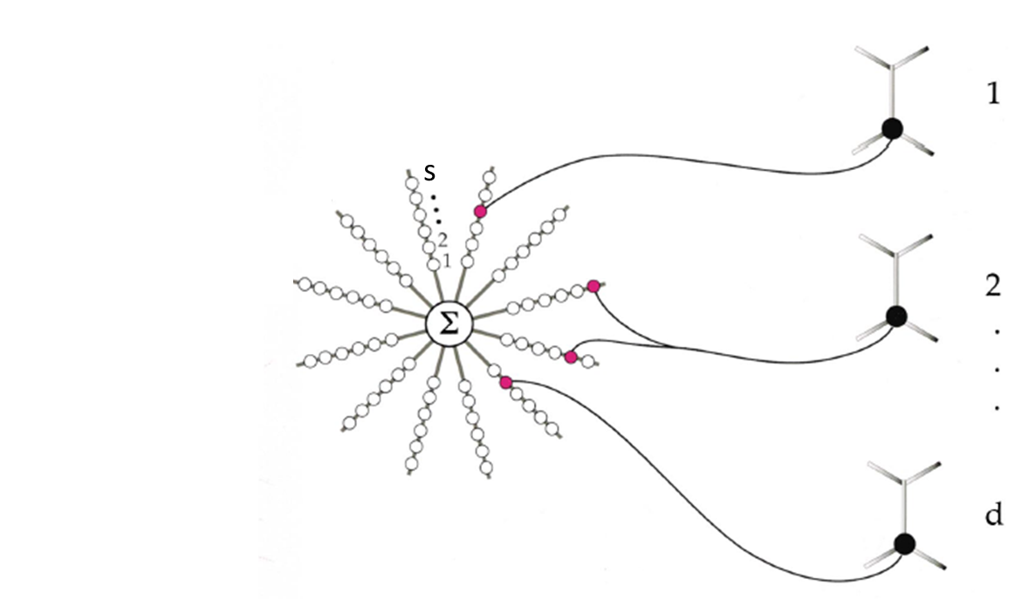
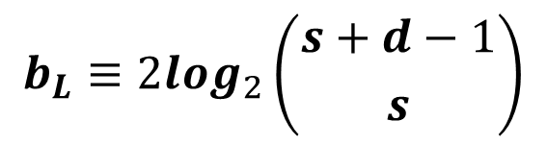
Defining an efficiency morphospace
Storage capacity
$$b_{L}≡2\log_{2}\left({s+d−1 \atop s}\right)$$
(Poirazi & Mel, 2001)
Notes:
The storage capacity as

Slide 27

Pareto optimality for single neurons
Storage capacity
Pareto front
Routing Efficiency
In a Pareto optimal configuration one functionality cannot increase without decreasing another
Notes:
Now I can use these metrics to define the optimality of the system.
To this aim I used the concept of pareto optimality which is built on the idea that a system devoted to various functions in order to be globally optimal muy obbey trade off between the performances in those functions. This means that to maximize the signal integration, that I call routing efficiency, and the storage capacity there are a set of configurations which cannot increase one of them without negatively impacting the other.

Slide 28
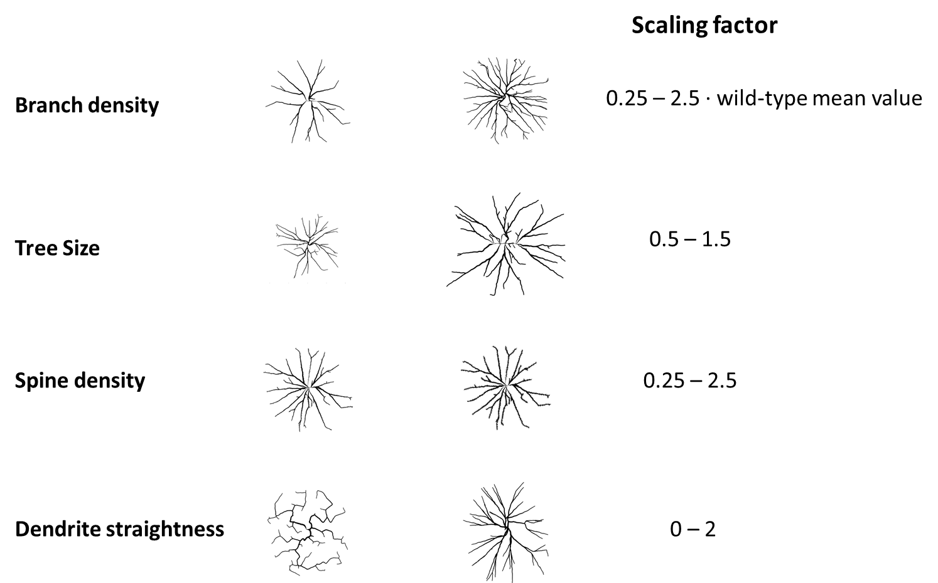

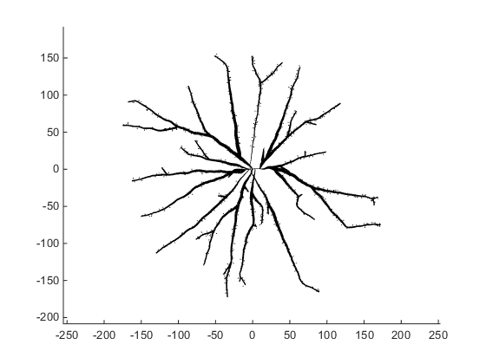
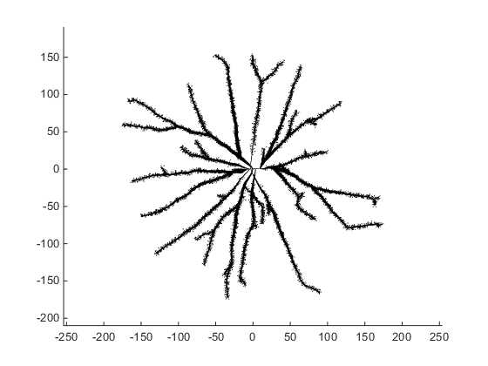
In-silico exploration of the morphospace
zoom
zoom
Notes:
To define the pareto optimal cases I used a compuational exploration by generating synthetic tres usng the tree cloning tool of tress toolbox with scaling factors around the WT vaues

Slide 29
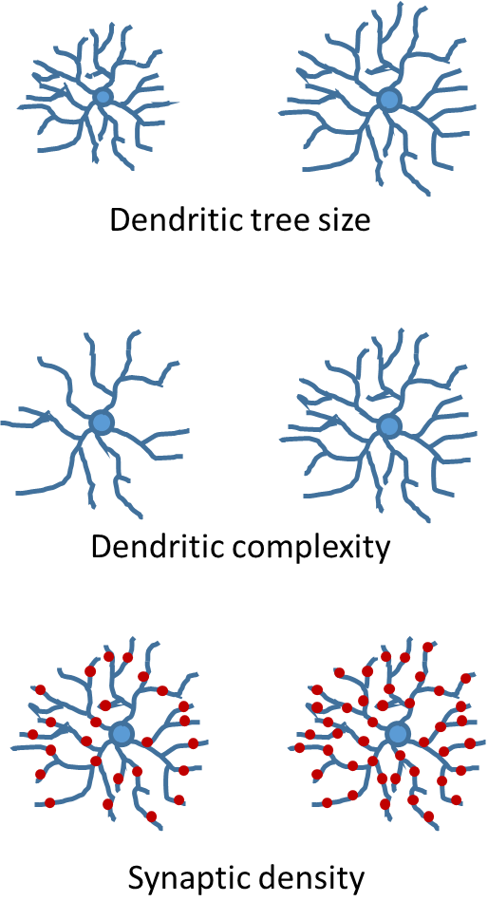
Spine density increases routing efficiency linearly
Cost
Routing Efficiency
Storage Capacity
1.5
1.0
Variable ratio vs wild-type
0.5
0.5
1.0
1.5
2.0
0.5
1.0
1.5
2.0
0.5
1.0
1.5
2.0
Scaling factor
Notes:
In this exploration I found that increasing spine density

Slide 30
Branch density increases storage capacity asymptotically
Cost
Routing Efficiency
Storage Capacity
1.5
1.0
Variable ratio vs wild-type
0.5
0.5
1.0
1.5
2.0
0.5
1.0
1.5
2.0
0.5
1.0
1.5
2.0
Scaling factor

Slide 31
Tree size increases storage capacity
Cost
Routing Efficiency
Storage Capacity
2.0
1.5
Variable ratio vs wild-type
1.0
0.5
0.6
0.8
1.0
1.2
1.4
0.6
0.8
1.0
1.2
1.4
0.6
0.8
1.0
1.2
1.4
Scaling factor
Notes:
Instead, when incresing dendritic tree size,

Slide 32
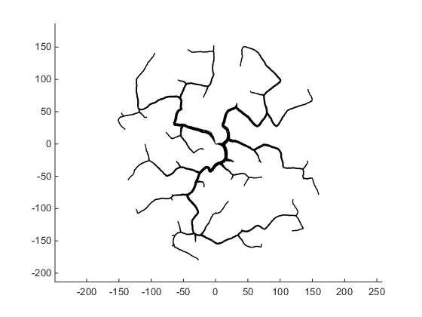
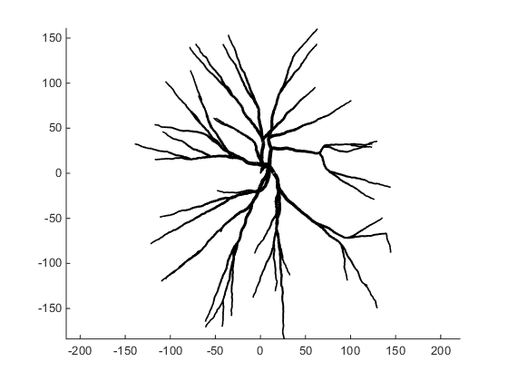
Dendrite straightness increases routing efficiency
Cost
Routing Efficiency
Storage Capacity
1.5
1.0
Variable ratio vs wild-type
0.5
0.0
0.5
1.0
1.5
2.0
0.0
0.5
1.0
1.5
2.0
0.0
0.5
1.0
1.5
2.0
Balancing factor
Notes:
Finally, incresing dendrite …

Slide 33
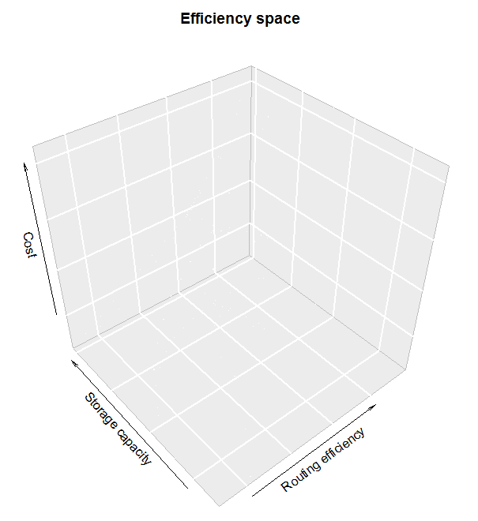
The exploration defines an efficiency morphospace
Branch density
Notes:
This exploration defined an efficiency morphospace that contrary to what we expected was not having linear dependencies among all the metrics but instead, had an asymptotic dependency between storage capacity and cost, indicating that storage capacity saturates for high spine and dendritic density values

Slide 34
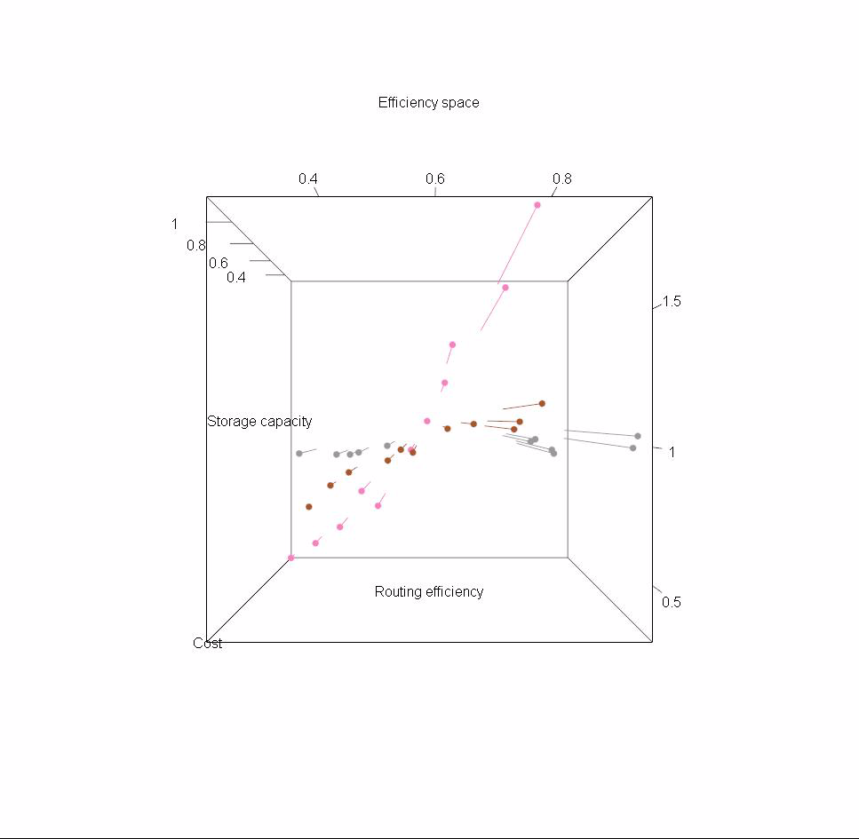
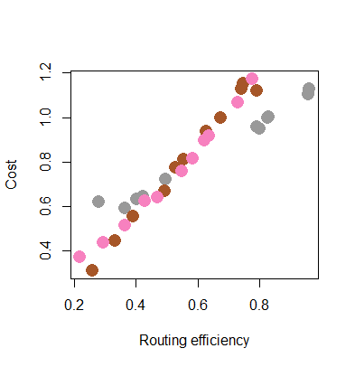
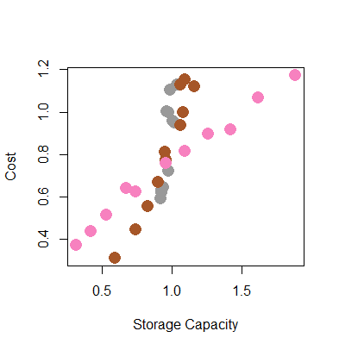
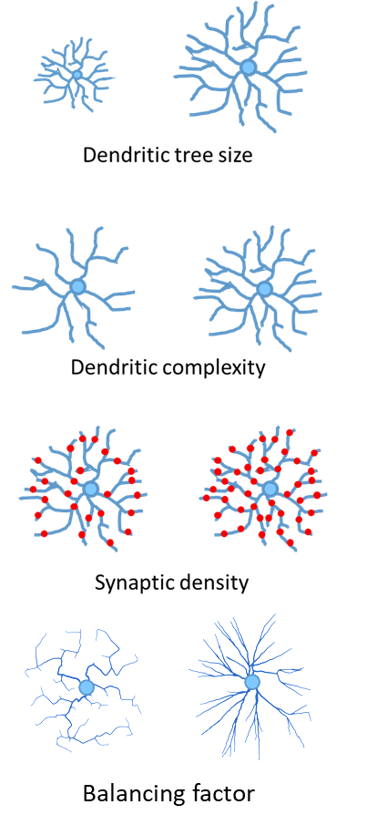



Straightness and tree size explorations define Pareto fronts for routing efficiency and storage capacity
Branch density
Tree size
Dendrite straightness
Notes:
In these 2D projection we can see that…

Slide 35


Straightness and tree size explorations define Pareto fronts for routing efficiency and storage capacity
Intellectual disability mouse models
Branch density
Dyrk1A +/-
Tree size
Ts65Dn
Ctrl-Dyrk1A +/-
Ctrl-Ts65Dn
Dendrite straightness
Notes:
When we plot our biological models in this projections, we see that both control strains are beyond the pareto front for routing efficiency, suggesting the they are optimaly wired for this parameter, but instead for storage capacity they are not optimal.
In the case of the two models, both are suboptimal for storage capacity and less optimal than wt for routing efficiecy. In this case we can detect differences between trisomc and heterozygous neurons.

Slide 36

Interim conclusion
Morphospace exploration indicates dendritic tree size as the most relevant metric for storage capacity and dendrite straightness for routing efficiency
Down syndrome model cortical layer II/III pyramids have suboptimal space filling with reduced storage capacity and routing efficiency

Slide 37
What is the impact of suboptimal dendritic architecture on the network topology?
2D mosaic

Slide 38


Modeling neuronal connectivity
Few synapses
More synapses
Notes:
Pintar dibujos network nuevos
Explicar bien variability
Marcar diferencias entre network y single-cell

Slide 39
Modeling neuronal connectivity
Dendritic tree size variability
Dendritic tree size
Synaptic contact probability
(Orlandi et al., 2013)

Slide 40







Exploring the network morphospace
Cost
$$c≡\sum_{i<j}^{N}{w_{ij}l_{ij}}$$
Dendritic tree size
Routing efficiency
$E_{rout}≡\sum_{i,j}{\frac{1/φ_{ij}}{N(N−1)}}, i≠j$
Synaptic contact probability
Storage capacity
Exploring in-silico the impact of single cell metrics on the
network
$$B_{L}≡\sum_{i}{b_{i} }$$
Dendritic tree size variability
Notes:
Normalization to WT values has to be mentioned here
Comparativa entre métricas single-cell y network, marcar diferencia

Slide 41
Single cell synaptic contact probability increases network storage capacity asymptotically
Cost
Routing Efficiency
Storage Capacity
2.0
1.5
Variable ratio vs wild-type
1.0
0.5
0.5
1.0
1.5
2.0
0.5
1.0
1.5
2.0
0.5
1.0
1.5
2.0
Scaling factor

Slide 42
Dendritic tree radius increases storage capacity superlinearly
Cost
Routing Efficiency
Storage Capacity
2.0
1.5
Variable ratio vs wild-type
1.0
0.5
0.6
0.8
1.0
1.2
1.4
0.6
0.8
1.0
1.2
1.4
0.6
0.8
1.0
1.2
1.4
Scaling factor

Slide 43
Tree size variability has no impact on network routing efficiency and storage capacity
Cost
Routing Efficiency
Storage Capacity
1.08
Variable ratio vs wild-type
1.04
1.00
0.5
1.0
1.5
2.0
2.5
0.5
1.0
1.5
2.0
2.5
0.5
1.0
1.5
2.0
2.5
Scaling factor

Slide 44

Synaptic contact probability is constant
Notes:
To thus aim I introduced the radial dependency in contact probability in the model

Slide 45


Are subtle neuromorphological properties relevant for network topology?
(Spruston, Nat.Rev.Neuroscience, 2008)
Notes:
However, in this exploration we did not take into account the position of the contact along the dendritic tree. This is important since a wide number of studies have demonstrated that the topology of spines defines its electrophysiological properties

Slide 46

Introducing radial dependency in the synaptic contact probability
Notes:
To thus aim I introduced the radial dependency in contact probability in the model

Slide 47
Introducing radial dependency on the synaptic contact probability increases routing efficiency
Cost
Routing Efficiency
Storage Capacity
2.0
1.5
Constant
Variable ratio vs wild-type
Radial dependency
1.0
0.5
0.5
1.0
1.5
2.0
0.5
1.0
1.5
2.0
0.5
1.0
1.5
2.0
Scaling factor
Notes:
In doing so I observed that routing efficiency at the network level increases while keeping constant the material cost

Slide 48




Tree size and synaptic density define Pareto fronts for storage capacity and routing efficiency respectively
Synaptic contact probability
Dendritic tree size
Dendritic tree size variability
Notes:
With the explorations ....

Slide 49

Intellectual disability mouse models for analyzing perturbed pyramidal microanatomy
Notes:
If we now parametrize this model with experimental data from our biological samples

Slide 50
Dendritic tree size and synaptic contact probability define Pareto fronts for storage capacity and routing efficiency
Synaptic contact probability
Dendritic tree size
Dyrk1A +/-
Ts65Dn
Ctrl-Ts65Dn
Dendritic tree size variability
Notes:
We observe that ...

Slide 51


Interim conclusion
Suboptimal single-neuron wiring permeates to the network level, implying suboptimal capacities for routing efficiency and storage capacity
Introducing radial dependency in synaptic contact probability implies increased optimality for network routing efficiency
$E_{rout}≡\sum_{i,j}{\frac{1/φ_{ij}}{N(N−1)}}, i≠j$
$$B_{L}≡\sum_{i}{b_{i} }$$
Notes:
Given that subtle variations in dendritic tree structure can lead to deviations from optimality, the next relevant question was to determine to what extend Within-class cell morphology variability could be relevant to explain differential comptational capabilities of brain network in different regions.

Slide 52

Natural variation in the structural properties of neurons
Notes:
Given that my models show that subtle neuromorphological changes derive in important functional consequences, it was relevant to explore the natural variation in the structural properties of neurons

Slide 53


Exploring position-dependent within-class variability in CA1 hippocampal pyramids
Lateral
Medial
Dorso-ventral
Antero-posterior
Medio-lateral
The hippocampus is involved in learning and memory and is impaired in Intellectual disability
Notes:
Given that subtle variations in dendritic tree structure can lead to deviations from optimality, the next relevant question was to determine to what extend Within-class cell morphology variability could be relevant to explain differential comptational capabilities of brain network in different regions.
To this aim I focused in the hippocampus CA1, a well defined hippocampal subregion with important contribution to spatial learning, which is altered in DS mouse models.

Slide 54



Wet-lab experiment: LY-labeled and reconstructed CA1 pyramidal dendritic trees
Control
TgDyrk1A
TgDyrk1A
Lucifer yellow injected hippocampal CA1 pyramidal cells of transgenic mice overexpressing Dyrk1A
Notes:
In this experiment I had to gather experimental data, given that previous studies had not assesed position dependent variations in DS
and thus existing neuronal reconstructions were lacking this information.
I selected to this aim transgenic mice overexpressing DYRK1A, and previously shown to bear dendritic abnormalities and vsuo.spatial memory deficits.

Slide 55

Exploring position-dependent within-class variability in CA1 hippocampal pyramids
Bregma -1.3 < -2.3
N br = 4
N n = 20

Slide 56
Position-dependent variations in CA1 apical dendritic tree architecture
Wild-type
TgDyrk1A
Dorso-ventral
Antero-posterior
Medio-lateral
400 μm
Notes:
Our neuronal reconstruction clearly demonstrated a position-dependent heterogeneity along the medio-lateral axis in both WT and transgenic pyramids

Slide 57

Position-dependent variations hinder genotype-dependent effects
Wild-type
TgDyrk1A
400 μm
Notes:
However, when pooling all the cell in different positions, we could identify only significant differences in maximum dendritic length and dendritic complexity.
The high levels of variance are certainly contributed by position dependent variance thus obscuring the real genotype-dependent effects

Slide 58



Position-dependent variations hinder genotype-dependent effects
Wild-type $L\sim {bp}^{0.72}$ s.e.=0.06
TgDyrk1A $L\sim {bp}^{0.66}$ s.e.=0.06
Notes:
This has also an impact when analyzing optimality, since, as you can observed both genotypes have optimal scaling

Slide 59


Genotype-dependent dendritic complexity differences in medial but not lateral CA1 dendritic trees
Medial
Lateral
Medial
Lateral
Notes:
When taking into account the position of the cells, we could observe a complexity gradient along the medio-latral axis of dorsal CA1, that allowed to discriminate genotype dependent differences in dendritic complexity. Specifcally transgenic dndritic tress were significantly less complex only in medial CA1 pyramids . One of the limitations in this experiments is the low number of cells that we could reconstruct per position

Slide 60


The need of mesoscopic perspectives
Notes:
These experiments clearly supported the need of devising an experimental framework that could address neuromorphology from a ppopùlation perspective, at the mesoscopic scale

Slide 61


Genetic labelling as a useful tool for mesoscopic analysis: the Thy1-YFP model
X
Dyrk1A
TgDyrk1A
Notes:
For developing the mesoscopic analysis framework, we used genetically labellledmice, in which the Yellow fluorescent gene expression is guided by the Thy1 promoter which direct the expression of the foreign gene exclusively to pyramidal neurons. These mice were crossed to TgDyrk1A to obtain double transgenics
Here I used 150 micron slices from thedorsal hippocampus of double transgenic

Slide 62

Methods to study cellular and dendritic density from a mesoscopic perspective
Notes:
The first step was to dvelopa processing and analysis toolbox.

Slide 63




Methods to study cellular and dendritic density from a mesoscopic perspective
Stereology
Our method
Notes:
For cell density analysis we used…
To validate themetod we compared our results with measuring cell density in this same samples with well established stereological methods. As yyou can see in this plot representing ….
Moreover, our method validate previous results showing cell density differences between CA1 and CA3

Slide 64

Methods to study cellular and dendritic density from a mesoscopic perspective
(Ropireddy et al.,2012)
Notes:
This same result was also obtained when comparing dendritic density with our population based method in hese layers
Specifically, our method uses….

Slide 65

Mesoscopic dendritic density analysis in TgDyrk1A
Reduced dendritic density in distal CA1
Notes:
Explain PLOT!
These methods allowed to detect not only cell density differences in TgDyrk1A, but also reproduced previous data on dendritic density

Slide 66
Interim conclusion
Structural inhomogeneities in CA1 pyramids identify position dependent genotype differences
Population-based analysis methods can capture structural inhomogeneities and allow systems-perspective analysis

Slide 67


Next generation CLARITY: the path to whole-brain imaging with microscopic resolution
Notes:
In his last part of my presentation I would like to summarize he effort done to contextualize the population based analysis in a whole brain perspective. A strong effort was made, as reflected in my Thesis manuscript to implement…

Slide 68


Multi-scale neuroanatomical alterations in Down syndrome mouse models
Wild-type
TgDyrk1A
Notes:
Initial experiments already indicate that this tools will be very important for gathering a systems multiscale neuroanatomical descriptions in DS. However, I still cannot present statistical analysis since these experiments are ongoing.
The clear advantage of this perspective is that we can now move from the local perspective to understand how organizational changes in the microscale affect whole-brain networks

Slide 69


A step towards mesoscopic modeling of neuronal circuits
A generative model for assessing the link with network topology at the mesoscopic scale
Notes:
Again, there is a lack of computational models able to integrate the population based information of whole brain samples. Thus, I am generating a model…
Although still work in progress

Slide 70


Slide 71

Conclusions
Morphospace exploration indicates that dendritic tree size is the most relevant metric for storage capacity and dendrite straightness for routing efficiency
Down syndrome model cortical layer II/III pyramids have suboptimal space filling with reduced storage capacity and routing efficiency
Suboptimal single-neuron wiring permeates to the network level, implying suboptimal capacities for routing efficiency and storage capacity
Introducing radial dependency in synaptic contact probability implies increased optimality for network routing efficiency
Structural inhomogeneities in CA1 pyramids identify position dependent genotype differences
Population-based analysis methods can capture structural inhomogeneities and allow systems-perspective analysis

Slide 72


Mara Dierssen
Jordi García Ojalvo
Hermann Cuntz
Inma Ballesteros
Cellular and Systems neurobiology lab
Linus minilab

Slide 75
Dendritic tree size and synaptic contact probability define Pareto fronts for storage capacity and routing efficiency respectively
Synaptic contact probability
Dendritic tree size
Dendritic tree size variability
Notes:
Without models first, with models afterwards

Slide 76

Dendritic tree size and synaptic contact probability define Pareto fronts for storage capacity and routing efficiency respectively
Synaptic contact probability
Dendritic tree size
Dendritic tree size variability

Slide 77

Dendritic tree size and synaptic contact probability define Pareto fronts for storage capacity and routing efficiency respectively

Slide 78

CA1 apical dendritic trees have reduced storage capacity

